Slide 1
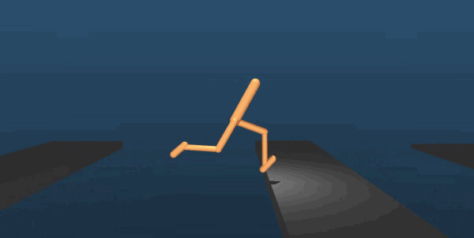
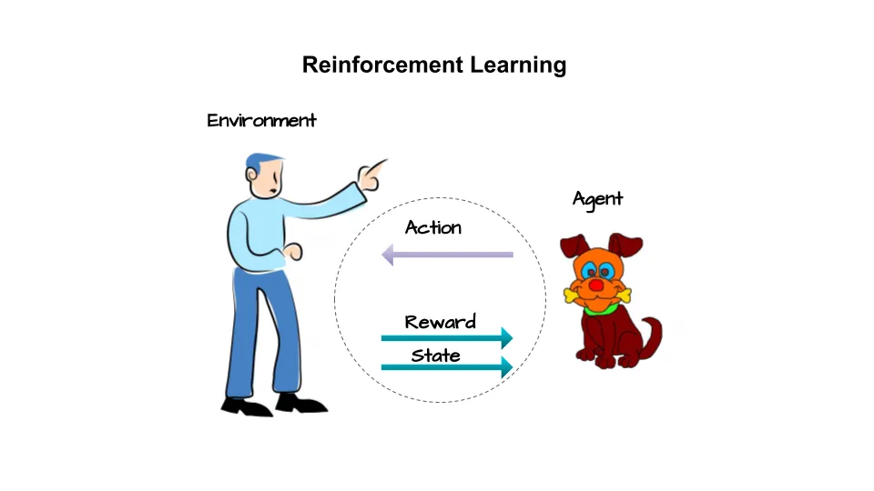
Reinforcement learning
A machine learning approach where an agent learns to make optimal decisions by interacting with an environment.
Maximizes a given reward through trial and error.
Receives observations from the environment.
Takes actions based on its current state.
Gets rewards or penalties based on actions taken.
Optimizes behavior over time to achieve the best outcomes.

Slide 2
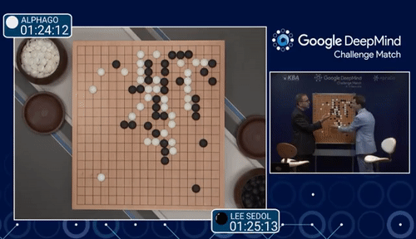
AlphaGo
DeepMind's artificially intelligent Go player that beat the world champion of Go

Slide 3

#Quiz1
Reinforcement learning agents/models seek to
A) Exhibit creativity
C) Maximize a given reward
B) Interpret the state of an environment
D) Explore an environment
Well done!

Slide 4
Markov decision processes
MDP give us a way to formalize sequential decision making.
This formalization is the basis for structuring problems that are solved with reinforcement learning.
‹#›

Slide 5
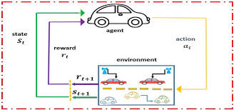
Components of an MDP
Agent
Environment
State
Action
Reward
The agent iteratively selects actions, transitions between states, and receives rewards, forming a trajectory of its interactions.
It is the agent's goal to maximize the cumulative rewards.

Slide 6
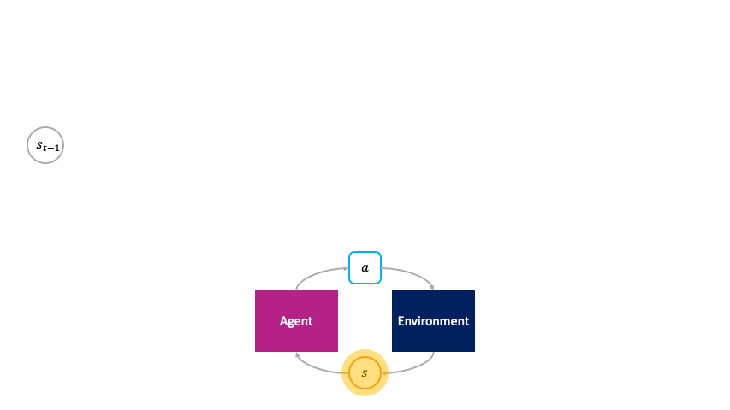
MDP Notation
The MDP consists of a finite set of states S, actions A, and rewards R.
At each time step t, the agent observes the environment’s state St​, selects an action At​, and transitions to a new state St+1​, receiving a reward Rt+1​.
The reward function f(St,At)=Rt+1 ​ maps state-action pairs to rewards.
This sequential decision-making process forms a trajectory: S0,A0,R1,S1,A1,R2,S2,A2,R3,…

Slide 7
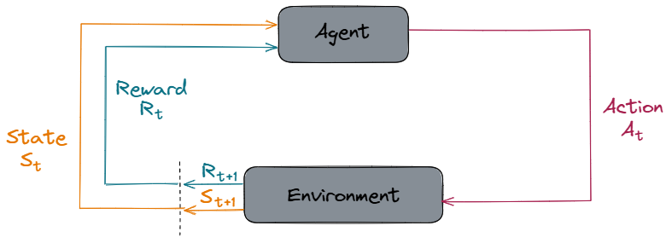
This diagram nicely illustrates this entire idea.
At time t, the environment is in state St.
The agent observes the current state and selects an action At​.
The environment transitions to a new state St+1​ and provides the agent with a reward Rt+1​.
This cycle repeats for the next time step, t+1.
Once t+1 arrives, it becomes the present moment. When crossing the transition boundary, the previous St+1 and Rt+1 now serve as the current St and Rt ​.

Slide 8
#Quiz2
What does MDP stand for?
A) Markov Delicate Program
C) Modern Derivative Parallel
B) Markov Decision Process
D) Modern Dealing Process
Next

Slide 9
The state and reward at time t depend on which of the following?
A)
C)
State-action pair for all time instances before t
Cumulative reward at time t
B) Agent Dynamics
D)
State-action pair for time (t-1)
Next

Slide 10
In an MDP, the _______________'s objective is to maximize the total reward.
A) Agent
C) Action
B) Reward
D) State
Next

Slide 11
What is the correct order for the components of an MDP?
A) State, Agent, Environment, Action, Reward
C) Agent, Environment, State, Action, Reward
B) Agent, State, Environment, Action, Reward
D) Environment, Agent, State, Action, Reward
Well done!

Slide 12
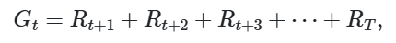
Expected Return - What Drives a RL Agent in an MDP
Expected return
The goal of an agent in an MDP is to maximize its cumulative rewards. We need a way to aggregate and formalize these cumulative rewards.
For this, we introduce the concept of the expected return of the rewards at a given time step.
For now, we can think of the return simply as the sum of future rewards. Mathematically, we define the return G at time t as
It is the agent's goal to maximize the expected return of rewards.
where T is the final time step.

Slide 13
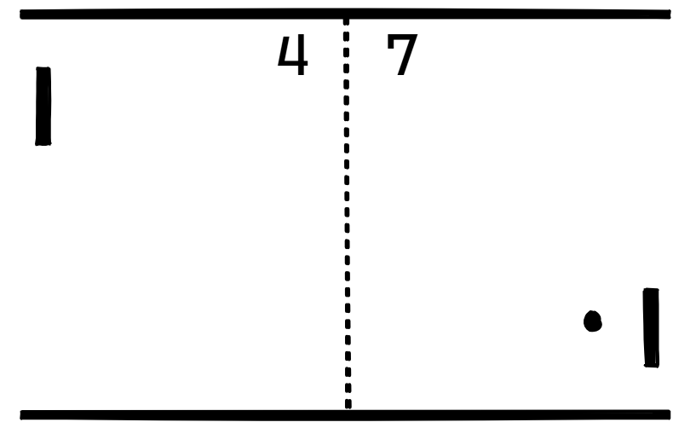
Episodic vs. continuing tasks
Episodic Tasks:
Some tasks naturally break into episodes with a final time step T(e.g., a game of Pong where each round is an episode).
After reaching a terminal state, the environment resets before starting a new episode.
Continuing Tasks:
Other tasks do not have a clear endpoint and continue indefinitely (e.g., stock trading, robot control).
These tasks lack a final time step, making it difficult to define a return using finite sums.
Since continuing tasks can have T=∞, the return could be infinite.
To handle this, a refined method for computing return is needed (e.g., discounted rewards with a discount factor γ).
Continuing tasks

Slide 14
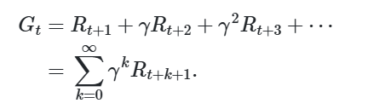
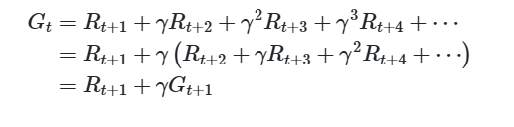
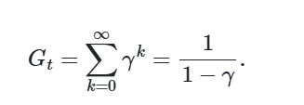
Discounted return
The agent will be choosing action At at each time t to maximize the expected discounted return.
Discounted return formula:
Recursive Relationship of Return:
Finite Discounted Return from Infinite Sum

Slide 15
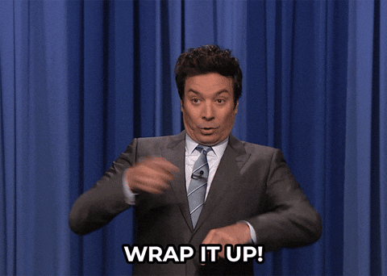
Wrapping up
The main take-away here is that it is the agent's objective to maximize the expected discounted return of rewards. While the agent does consider all of the expected future rewards when selecting an action, the more immediate rewards influence the agent greater than rewards that are expected to be received further out due to the discount rate.

Slide 16
#Quiz3
In continuing tasks, how is it that the expected return is finite even though the series of rewards is infinite?
A) The sum of the infinite series of discounted rewards converges to a number.
C) The agent maximizes the return in the same manner as it does for an episodic task.
B) The agent maximizes only the immediate reward.
D)
The agent maximizes the expected return only of the first n rewards in the infinite series where n is an arbitrarily chosen number.
Next

Slide 17
Why do we discount the expected return of rewards?
A) The vanishing gradient problem
C) The return for continuing tasks could be infinite.
B) Returns from later episodes are not important.
D) The return for episodic tasks could be infinite.
Well done!

Slide 18
Policies and Value Functions
How good is a state or action?
A policy determines the probability of selecting an action from a given state, guiding the agent’s behavior.
Value functions measure how good a state or action is in terms of expected rewards, helping the agent make better decisions.
How probable is it for an agent to select any action from a given state? | Policies
How good is any given action or any given state for an agent? | Value functions

Slide 19
Policies
A policy is a function that maps a given state to probabilities of selecting each possible action from that state. We will use the symbol π to denote a policy.
When speaking about policies, formally we say that an agent “follows a policy.” For example, if an agent follows policy π at time t, then π(a|s) is the probability that At=a if St=s. This means that, at time t, under policy π, the probability of taking action a in state s is π(a|s).
Note that, for each state s∈S, π is a probability distribution over a∈A(s).

Slide 20
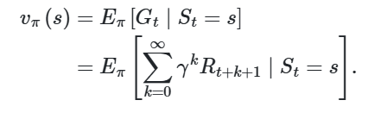
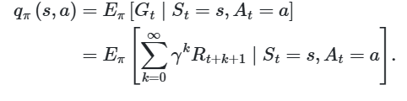
Value functions
State-value function
Value functions are functions of states, or of state-action pairs, that estimate how good it is for an agent to be in a given state, or how good it is for the agent to perform a given action in a given state.
Action-value function
Evaluates an Action's Quality
Evaluates a State's Quality
The action-value function is often called the Q-function.
The Q-value represents the quality of taking an action in a given state.

Slide 21
#Quiz4
What is the difference between a state-value function and an action-value function for an agent following a given policy?
A) The state-value function tells us how good any given state is for the agent, whereas the action-value function tells us how good it is for the agent to take any action from a given state.
C) Both functions are the same.
B) The state-value function tells us the state as well as the action, whereas the action-value function tells us only the action for any state.
The state-value function tells us the policy, whereas the action-value function tells us the action and state.
D)
Next

Slide 22
Value functions are defined with respect to _______________.
A) the policy
C) the expected return, specific ways of acting, and the policy
B) the expected return
D) specific ways of acting
Well done!

Slide 23
What do Reinforcement Learning Algorithms Learn - Optimal Policies
Optimality
It is the goal of reinforcement learning algorithms to find a policy that will yield a lot of rewards for the agent if the agent indeed follows that policy. Specifically, reinforcement learning algorithms seek to find a policy that will yield more return to the agent than all other policies.

Slide 24
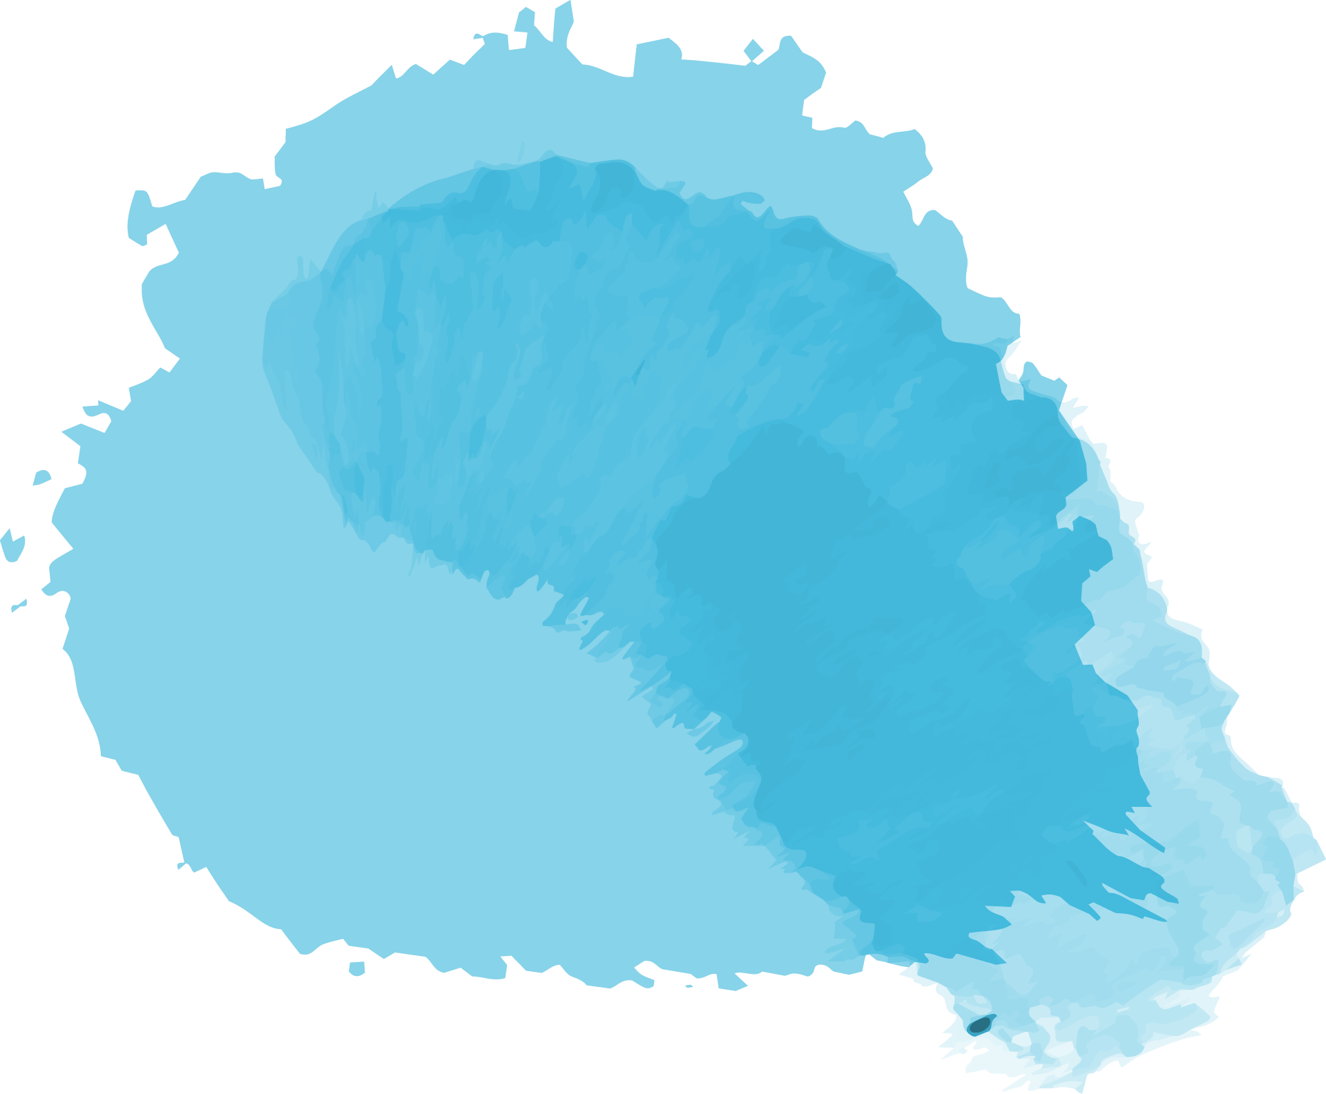
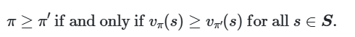
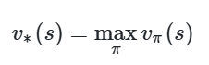
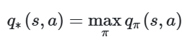
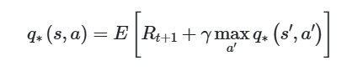
Optimal policy
Optimal state-value function
Optimal action-value function
Bellman optimality equation

Slide 25
#Quiz5
How can we determine whether an action-value function is optimal?
A) For any state-action pair, the function produces the expected reward for taking that action plus the maximum discounted return thereafter.
C) For any state-action pair, the function yields the maximum future rewards.
B) For any state-action pair, the function yields the discounted rewards of following the optimal policy.
D) For any state-action pair, the function produces the reward for taking that action.
Next

Slide 26
What is QLearning ?
Q-learning is an RL algorithm that learns the optimal policy by associating state-action pairs with Q-values, representing the expected cumulative reward.
Value iteration
The Q-learning algorithm iteratively updates the Q-values for each state-action pair using the Bellman equation until the Q-function converges to the optimal Q-function, q∗. This approach is called value iteration.

Slide 27
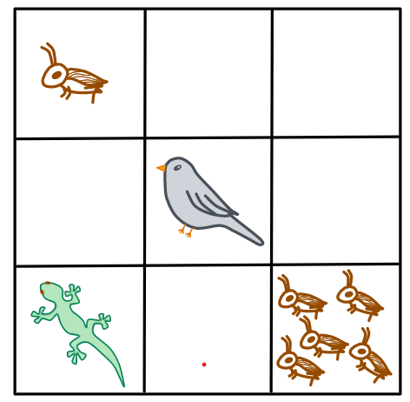
Exemple : The Lizard Game
Agent : Lizard
Actions : Left, right, up, or down
State | Reward
One cricket | +1
Empty | - 1
Five crickets | +10 Game over
Bird | - 10 Game over

Slide 28
Storing Q-Values In A Q-Table
Actions
 | Left | Right | Up | Down
1 Cricket | 0 | 0 | 0 | 0
Empty 1 | 0 | 0 | 0 | 0
Empty 2 | 0 | 0 | 0 | 0
Empty 3 | 0 | 0 | 0 | 0
Bird | 0 | 0 | 0 | 0
Empty 4 | 0 | 0 | 0 | 0
Empty 5 | 0 | 0 | 0 | 0
Empty 6 | 0 | 0 | 0 | 0
5 Crickets | 0 | 0 | 0 | 0
States

Slide 29
Episodes
The learning process for the lizard takes place over a set number of episodes.
In each episode, the lizard chooses an action based on the current Q-values in the Q-table for the current state.
All the Q-values are set zero at the start
What action does it start with?

Slide 30
Exploration Vs. Exploitation
Exploration
Exploitation
Exploration is the act of exploring the environment to find out information about it.
Exploitation is the act of exploiting the information that is already known about the environment in order to maximize the return

Slide 31
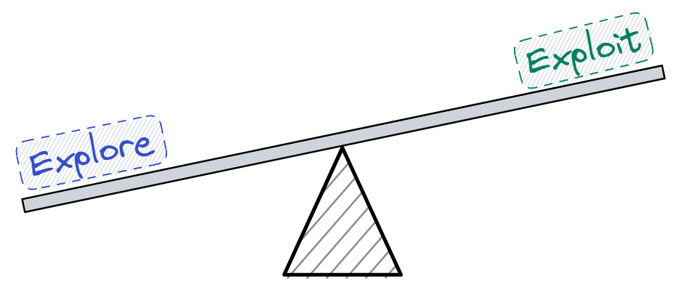
Epsilon Greedy Strategy
The epsilon greedy strategy balances exploration and exploitation by defining an exploration rate initially set to epsilon, which gradually decreases over time.
random_num > epsilon:
choose action via exploitation
random_num < epsilon
choose action via exploration

Slide 32
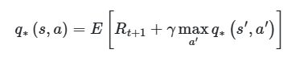
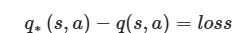
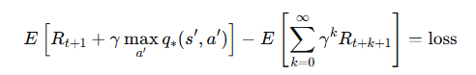
Updating the Q-value
The Q-value for an action is updated using the Bellman equation:
The goal is to make the Q-value for a state-action pair match the optimal Q-value over time.
This is done by iteratively reducing the loss, calculated as:
The loss is computed as the difference between expected rewards and predicted Q-values:
To update the Q-value effectively, the learning rate must be introduced.
The lizard's first action is chosen randomly due to an exploration rate of 1, meaning it fully explores at the start.
After taking an action, it observes the next state, receives a reward, and updates the Q-value in the Q-table.
If the lizard moves right, it lands on an empty tile with a reward of −1.
Choosing an action

Slide 33
The learning rate
The learning rate (α) is a value between 0 and 1 that controls how much the new Q-value replaces the old one.
It determines how quickly the agent adapts to new information while updating the Q-table.
Instead of fully replacing the old Q-value, the learning rate blends the previous estimate with the newly computed Q-value.
A higher learning rate (α≈1) makes the agent quickly adopt new values but may lead to instability.
A lower learning rate (α≈0) makes learning slower but ensures stability by retaining past knowledge.

Slide 34
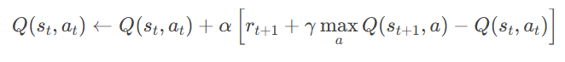
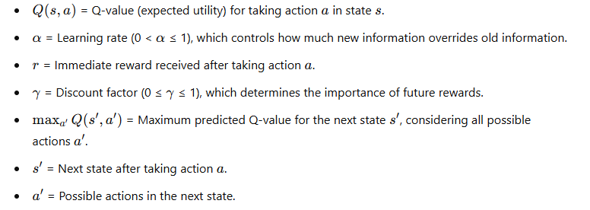
Updating The Q-Value
To update the Q-value for the action of moving right taken from the previous state, we use the Bellman equation .

Slide 35
#Quiz6
Using Q-learning with value iteration, the new Q-value calculated at a given timestep is equal to the weighted sum of the old value and the _______________.
A) Maximum value
Starting value
C)
B) Learned value
D) Final value
Next

Slide 36
By setting the learning rate to 1, _______________.
A) The agent won't consider previous experiences in calculating the Q-value for a given state-action pair.
C) The updating process will be very slow.
B) The new Q-value will always be the same.
D) The agent will always get low rewards.
Next

Slide 37
When all the actions in the Q-table have a Q-value of 0 in the first episode, the agent will _______________.
A)
C)
exploit the the environment with an exploration rate of 1
Explore the environment with an exploration rate of 1
B)
D)
explore the environment with an exploration rate of 0.5
explore and exploit the environment with an exploration rate of 0.5
Well done!

Slide 38
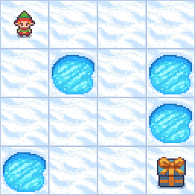
OpenAI Gym and Python for Q-learning - Reinforcement Learning Code Project
FrozenLake Environment
The FrozenLake environment is a grid-world game where the agent must navigate from the start (S) to the goal (G) without falling into holes (H). The surface is slippery, so the agent doesn't always move in the intended direction.
States: Each cell in the grid is a state.
Actions: The agent can move in 4 directions: Left (0), Down (1), Right (2), Up (3).
Rewards:
Reaching the goal: +1
Falling into a hole: 0
Otherwise: 0

Slide 39
Why Reinforcement Learning ?
is_slippery=True
If true the player will move in intended direction with probability of 1/3 else will move in either perpendicular direction with equal probability of 1/3 in both directions.
For example, if action is left and is_slippery is True, then:
P(move left)=1/3
P(move up)=1/3
P(move down)=1/3

Slide 40
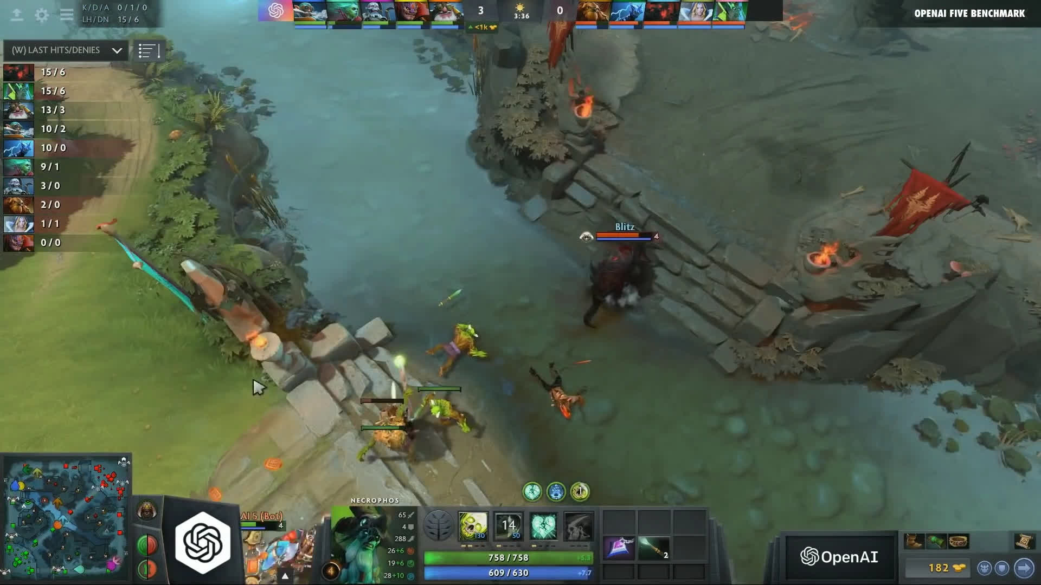
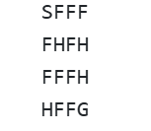
Deep Q-Learning - Combining Neural Networks and Reinforcement Learning
Limitations of Q-learning with value iteration
In the Frozen Lake environment, with only 16 states and 4 actions, the Q-table contains 64 values to update. As the state space grows, the time required to explore all states and iteratively update Q-values increases significantly.
In a large video game environment, each state is represented by pixels, and multiple actions are possible per state.
Updating Q-values for every state-action pair becomes computationally inefficient and infeasible due to the high resource and time requirements.

Slide 41
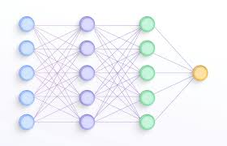
Deep Q-learning
We'll make use of a deep neural network to estimate the Q-values for each state-action pair in a given environment, and in turn, the network will approximate the optimal Q-function.
The act of combining Q-learning with a deep neural network is called deep Q-learning, and a deep neural network that approximates a Q-function is called a deep Q-Network, or DQN.

Slide 42
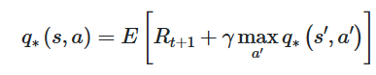
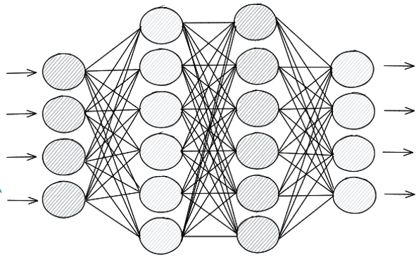
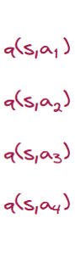
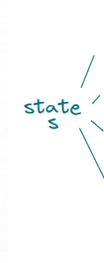
Deep Q-networks

Slide 43
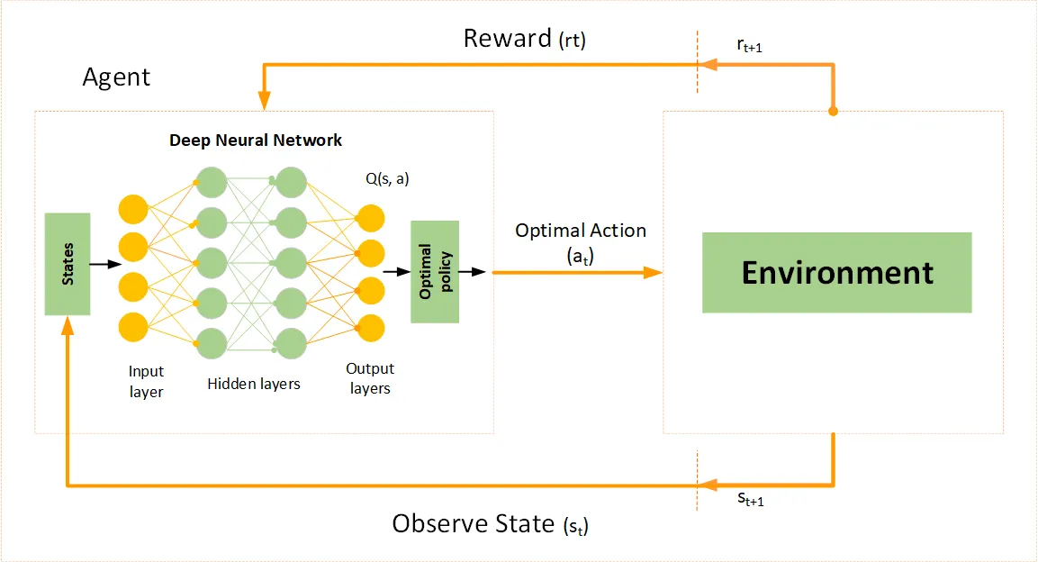
After calculating the loss, the network updates its weights using Stochastic Gradient Descent (SGD) and backpropagation, just like any other neural network. This process repeats for each state in the environment until the loss is minimized and the Q-function is optimized
Previously, we used the Bellman equation to update Q-values in a table to find the optimal Q-function. In deep Q-learning, a neural network estimates Q-values using the Bellman equation, replacing value iteration with deep learning.

Slide 44
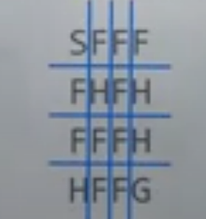
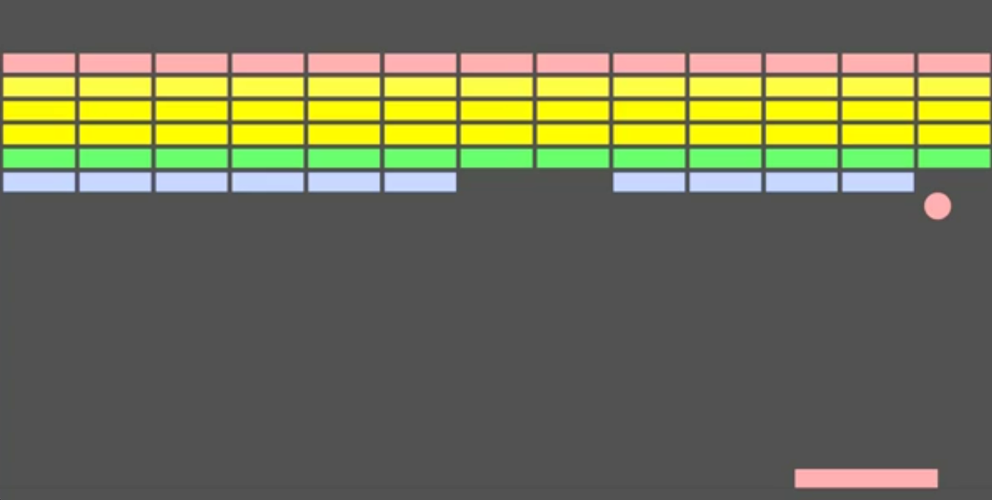
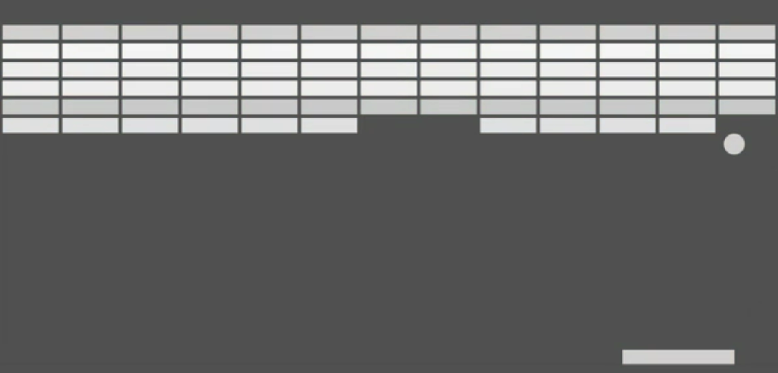
The input
The network would accept states from the environment as input. Thinking of Frozen Lake, we could easily represent the states using a simple coordinate system from the grid of the environment and use this as input.
In a more complex environment, though, like a video game, for example, then we'll use images as our input. Specifically, we'll use still frames that capture states from the environment as the input to the network.
Standard preprocessing converts RGB frames to grayscale, crops unimportant areas, and scales the image to reduce size while preserving essential state information.

Slide 45
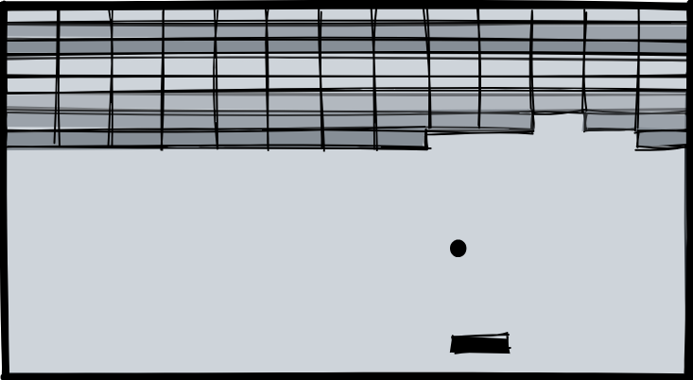
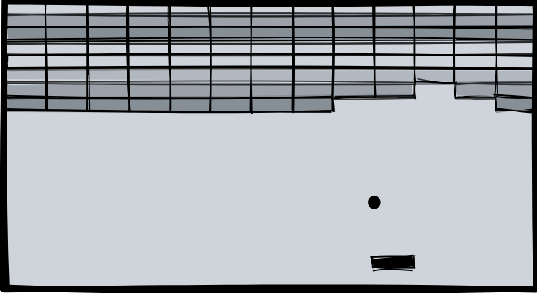
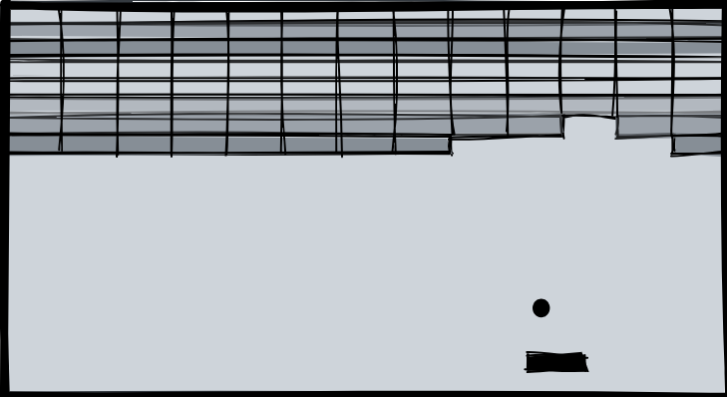
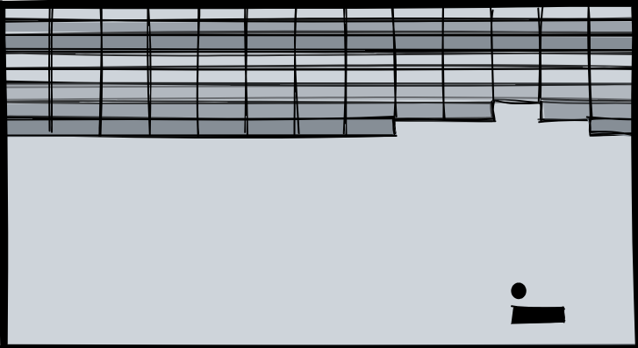
Instead of using a single frame as input, we typically use a stack of multiple consecutive frames (e.g., four) to provide temporal context. Each frame undergoes preprocessing (grayscale conversion, cropping, and scaling) before being stacked in the order they occurred in the game.
2
1
3
4

Slide 46
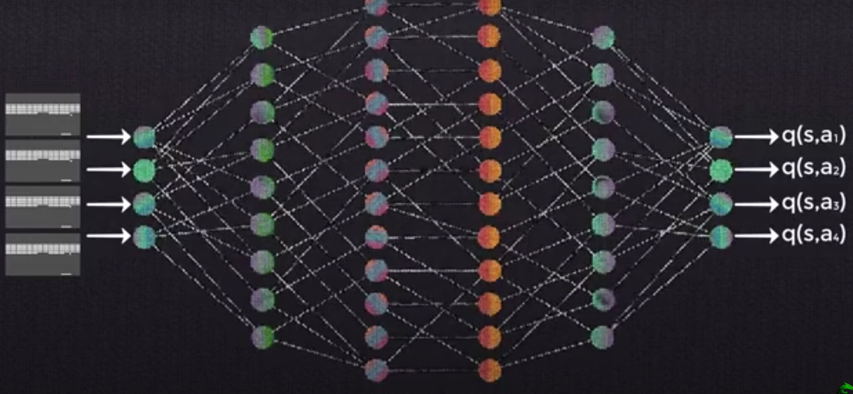
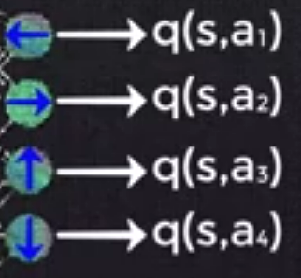
The layers
A Deep Q-Network consists of convolutional layers for feature extraction, followed by non-linear activation functions and fully connected layers to estimate Q-values. This structure is similar to standard deep learning models, making it straightforward and easy to understand.
The output
The output layer of a DQN is a fully connected layer that generates Q-values for each possible action in a given state. For example, if a game allows moving left, right, jumping, and ducking, the output layer will have four nodes, each representing the Q-value of one action.

Slide 47
#Quiz7
Which of the following is not true?
A) Q-learning is an on-policy method
C) A DQN combines Q-learning and deep neural networks
B) Training a DQN involves estimating Q-values by updating the weights of the neural network
D) Q-learning is a reinforcement learning technique
Next

Slide 48
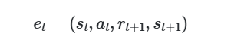
Experience Replay and Replay Memory
With deep Q-networks, we often utilize this technique called experience replay during training. With experience replay, we store the agent's experiences at each time step in a data set called the replay memory. We represent the agent’s experience at time t as et.
At time t, the agent's experience et is defined as this tuple:
This tuple contains the state of the environment st, the action at taken from state st, the reward rt+1 given to the agent at time t+1 as a result of the previous state-action pair (st,at), and the next state of the environment st+1.

Slide 49
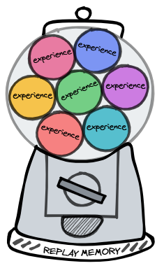
The agent's experiences at each time step are stored in a replay memory with a finite size, keeping only the most recent experiences. This ensures efficient learning while managing memory constraints.
The replay memory dataset is randomly sampled to train the network, allowing the agent to learn from past experiences. This process of storing and sampling experiences is known as experience replay.

Slide 50
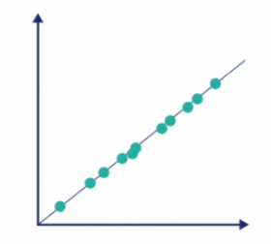
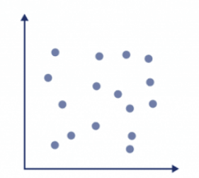
Why use experience replay?
Why would we choose to train the network on random samples from replay memory, rather than just providing the network with the sequential experiences as they occur in the environment?
A key reason for using replay memory is to break the correlation between consecutive samples.
If the network learned only from consecutive samples of experience as they occurred sequentially in the environment, the samples would be highly correlated and would therefore lead to inefficient learning. Taking random samples from replay memory breaks this correlation.

Slide 51
Combining a deep Q-network with experience replay
Setting up
Before training starts, we first initialize the replay memory data set D to capacity N. So, the replay memory D will hold N total experiences.
Size(D)=N
Then, we initialize the network with random weights.
Next, for each episode, we initialize the starting state of the episode. We talked about states, including the starting state, being a frame of raw pixels from a game screen as an example.

Slide 52
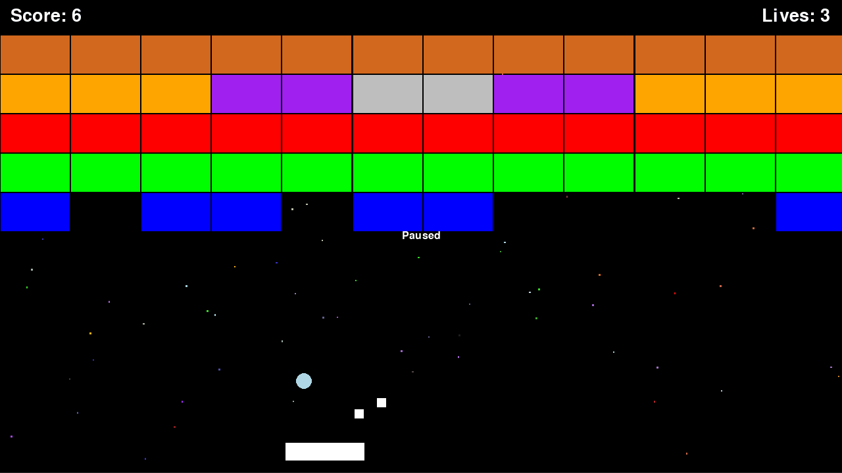
Gaining experience
Now, for each time step t within the episode, we either explore the environment and select a random action, or we exploit the environment and select the greedy action for the given state that gives the highest Q-value
We then execute the selected action at in an emulator. So, for example, if the selected action was to move right, then from an emulator where the actions were being executed in the actual game environment, the agent would actually move right. We then observe the reward rt+1 given for this action, and we also observe the next state of the environment, st+1.
We then store the entire experience tuple et=(st,at,rt+1,st+1) in replay memory D.

Slide 53
Training a deep Q-network with replay memory
Here's a summary of what we have so far:
Initialize replay memory capacity.
Initialize the network with random weights.
For each episode:
Initialize the starting state.
For each time step:
Select an action.
Via exploration or exploitation
Execute selected action in an emulator.
Observe reward and next state.
Store experience in replay memory.

Slide 54


The policy network
After storing an experience in replay memory, we then sample a random batch of experiences from replay memory.
N=6
For ease of understanding, though, we're going to explain the remaining process for a single sample, and then you can generalize the idea to an entire batch.

Slide 55

So from a single experience sample from replay memory, we then preprocess the state (grayscale conversion, cropping, scaling, etc.), and pass the preprocessed state to the network as input.
Going forward, we'll refer to this network as the policy network since its objective is to approximate the optimal policy by finding the optimal Q-function.

Slide 56




The input state data then forward propagates through the network, using the same forward propagation technique that we've discussed for any other general neural network. The model then outputs an estimated Q-value for each possible action from the given input state.
The loss is then calculated. We do this by comparing the Q-value output from the network for the action in the experience tuple we sampled and the corresponding optimal Q-value, or target Q-value, for the same action.
The target Q-value is calculated using the expression from the right hand side of the Bellman equation.
The loss is the difference between the estimated Q-value and the target Q-value.

Slide 57

Calculating the max term
When we are calculating the optimal Q-value for any given state-action pair, notice from the equation for calculating loss that we used above, we have this term here that we must compute:
Recall that s′ and a′ are the state and action that occur in the following time step.
Previously,we were able to find this max term by peeking in the Q-table. We'd just look to see which action gave us the highest Q-value for a given state.
In order to find this max term now, what we do is pass s′ to the policy network, which will output the Q-values for each state-action pair using s′ as the state and each of the possible next actions as a′. Given this, we can obtain the max Q-value over all possible actions taken from s′, giving us maxa′q∗(s′,a′).

Slide 58
Training the policy network
So after we're able to calculate the optimal Q-value for our state-action pair, we can calculate the loss from our policy network between the optimal Q-value and the Q-value that was output from the network for this state-action pair.
Gradient descent is then performed to update the weights in the network in attempts to minimize the loss. In this case, minimizing the loss means that we're aiming to make the policy network output Q-values for each state-action pair that approximate the target Q-values given by the Bellman equation
Up to this point, everything we've gone over was all for one single time step. We then move on to the next time step in the episode and do this process again and again time after time until we reach the end of the episode. At that point, we start a new episode, and do that over and over again until we reach the max number of episodes we've set. We'll want to keep repeating this process until we've sufficiently minimized the loss.

Slide 59
During training, we make two passes through the network. What is the purpose of the second pass?
To calculate the target reward for the current action
To calculate the reward for the current action
To calculate the Q-value for the current state and action

To calculate the max Q-value for the next state across all possible next actions

Slide 60

Training a deep Q-network with fixed Q-targets
Review: Training the policy network
Deep Q-Networks face instability because the same network is used to compute both Q-values and target Q-values. As the weights update, the target Q-values also change, making learning unstable and causing the model to "chase its own tail," leading to slow convergence. This issue arises because the targets continuously shift as the network learns, preventing stable optimization. A common solution is to use a separate target network that updates less frequently, providing more stable target Q-values and improving training stability.

Slide 61
The target network
Purpose: The target network is a separate, frozen copy of the policy network, used to compute stable target Q-values and reduce instability.
Functionality: Instead of using the policy network twice, the first pass calculates Q-values with the policy network, while the second pass (for target Q-values) uses the target network.
Updating Process: The target network's weights are updated periodically by copying the policy network's weights after a set number of time steps (a tunable hyperparameter).
Stability Improvement: This approach fixes Q-targets temporarily, preventing the model from constantly chasing moving targets, leading to more stable learning and better convergence.

Slide 62


Slide 63
#Quiz8
Why do we copy the policy network weight values to the target network weights every x time steps?
A) Using two different networks can secure us from the vanishing gradient problem.
C) It removes instability in the training process that is otherwise caused if we use the same network for calculating both the Q-values and target values.
B) Values in a single network update more slowly than if using two networks.
D) Separating networks is more computation-efficient.
Well done!

Slide 64

Frozen lake DQN
Epsilon Greedy Strategy
In terms of how the agent navigates the map both DQ learning and Q learning uses the Epsilon Greedy Strategy

Slide 65

Q_table vs Deep Q_network
0,11
0,22
0,3
0,1
Q_Values
16
04
0
1
0
0
0
0
0
0
0
0
0
0
0
0
0
0

Slide 66

Training the deep Q network
Deep Network formula

Slide 67


01
Create
02
Copy Policy
Policy (train)
Target
07
Set the target
0
0
0
0
0
0
0
0
0
0
0
0
0
0
1
0
0,001
-0,001
-0,001
-0,002
0,001
-0,001
-0,001
-0,002
03
Navigation
05
04
input
1
Q[14,2]=1
08
06
09
repeat
10
sync

Slide 68

Experience replay
deque
purged
3a
Memorize experience
3b
replay

Slide 69
Thank you for your
attention

